Slide 1
SpaceX Data Analysis Project
Abdullahi Osman Dair

Slide 2
Executive Summary
The SpaceX Data Analysis project aims to explore and analyze historical data on SpaceX launches to provide valuable insights into the company's performance, trends, and potential areas of improvement. The primary objective is to apply advanced data analysis techniques and machine learning models to a dataset containing details on various SpaceX missions, including launch success, vehicle types, mission outcomes, and key operational metrics.
he SpaceX Data Analysis project will provide key insights that can enhance SpaceX’s operational efficiency, improve decision-making, and contribute to the ongoing development of space exploration capabilities. By identifying critical success factors and utilizing predictive models, the project aims to optimize future launch missions and reduce risk.

Slide 3
The project seeks to address the following key goals:
Launch Success Prediction: Using historical data to develop predictive models that forecast the success or failure of future launches. This includes identifying factors that influence the probability of success, such as vehicle type, mission payload, and launch site.
Performance Insights: Conducting exploratory data analysis (EDA) to uncover trends in launch success rates over time, across different vehicle types, and among various mission categories. The analysis also includes studying the impact of specific operational factors, such as weather conditions, on launch performance.
Optimization of Launch Schedules: Leveraging data to recommend optimal times for launches based on past mission data, helping SpaceX streamline operations and reduce delays.
Machine Learning Implementation: Utilizing machine learning models like decision trees, random forests, and k-nearest neighbors (KNN) to predict the success or failure of upcoming missions. Hyperparameter tuning and cross-validation techniques will ensure the development of highly accurate models.

Slide 4
Overview of the SpaceX Project
SpaceX has revolutionized the space industry by significantly reducing the cost of rocket launches. One of the key innovations that enable these savings is the reusability of the Falcon 9 rocket's first stage. While other providers typically charge upwards of $165 million per launch, SpaceX offers a competitive price of $62 million, primarily due to the ability to reuse the first stage of the rocket, which accounts for a substantial portion of the cost. This reusability is made possible by the landing and refurbishment of the first stage after launch.
In this project, the goal is to build a machine learning pipeline that predicts whether the first stage of the Falcon 9 rocket will land successfully after a launch. The ability to accurately predict whether the first stage will land or not can provide valuable insights into the cost structure of SpaceX launches. Specifically, if the first stage is predicted to land successfully, it means the cost of the launch can be significantly reduced due to the reusability of the rocket.
This prediction can also be used by other companies considering bidding against SpaceX for rocket launches, enabling them to better understand the economic advantages of SpaceX's reusable technology.

Slide 5
Data Collection and Preparation for Analysis
The data used in this analysis was collected from historical SpaceX rocket launches, with a specific focus on whether the first stage of the Falcon 9 rocket successfully landed after the launch. The goal of this section was to gather data that would allow us to build a predictive model capable of determining if a first-stage landing would be successful.
The dataset contains records of SpaceX's Falcon 9 launches, including features such as:
Launch details (time, location, and rocket configuration)
Launch success/failure (whether the mission was successful)
First-stage landing success/failure (the target variable we are predicting)
Rocket specifications (e.g., type of rocket used, mass)
Payload information (e.g., payload weight, payload type)
Weather conditions at the launch site (e.g., wind speed, temperature)

Slide 6
Data Import
We first imported the data into our analysis environment using Python libraries like pandas and numpy.
import pandas as pd
# Load dataset
data = pd.read_csv("spacex_launch_data.csv")

Slide 7
Data Cleaning
Once the data was loaded, we performed several cleaning tasks to ensure the dataset was ready for analysis:
Handling Missing Data: We checked for missing values and imputed or removed rows with missing critical data points, especially for the target variable (landing_success), which is crucial for training the model.
Data Type Conversion: Some columns were incorrectly formatted (e.g., dates were in string format), so we converted them to appropriate data types (e.g., datetime for date fields, int or float for numerical features).
Removing Duplicates: We checked for duplicate entries and removed them to ensure the dataset only contained unique records.

Slide 8
Exploratory Data Analysis (EDA)
The main goal of conducting EDA was to uncover patterns, trends, outliers, and correlations within the dataset that could help understand the factors affecting the success of SpaceX rocket launches. By analyzing the data, we aimed to gain deeper insights into the relationships between variables and prepare the data for predictive modeling.
Tools and Techniques Used for Visualization
Matplotlib: Utilized for creating basic plots such as histograms, scatter plots, and line charts to understand data distributions and trends.
Seaborn: Used for generating more advanced and aesthetically pleasing plots such as box plots, violin plots, and heatmaps to visualize relationships and variability among variables.

Slide 9
Cont..
Interactive Tools Used for Deeper Insights
Plotly: Enabled the creation of interactive charts like scatter plots and bar graphs, allowing zooming, panning, and hovering for detailed data exploration.
Dash: Built an interactive dashboard to summarize key findings and visualize launch outcomes dynamically, allowing users to filter data and explore specific trends in depth.
Steps Taken During EDA
Data Cleaning . Initial Data Exploration . Trend Analysis
Outlier Detection . Correlation Analysis

Slide 10
Predictive Models and Techniques Used for Data Analysis
Models Used
To predict the likelihood of the first-stage rocket landing successfully, we utilized several classification models:
K-Nearest Neighbors (KNN):
A simple, distance-based model used to classify outcomes based on neighboring data points.
Ideal for baseline performance evaluation due to its simplicity and intuitiveness.
Decision Trees:
A tree-based algorithm that splits data based on feature importance.
Useful for identifying key factors influencing the landing outcome and providing interpretability.

Slide 11
Cont..
Logistic Regression:
A probabilistic linear model used for binary classification problems.
Useful as a baseline for performance comparison and understanding the linear relationship between features.
Support Vector Machines (SVM):
A model that aims to find the hyperplane that best separates classes.
Effective for high-dimensional data and where the decision boundary is not necessarily linear.

Slide 12
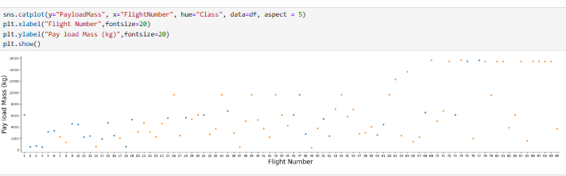
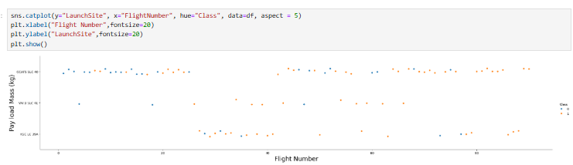
visualization results

Slide 13
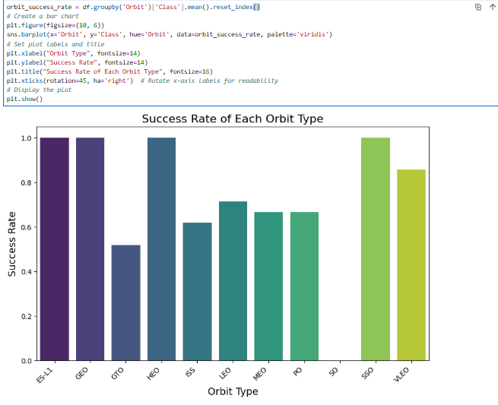
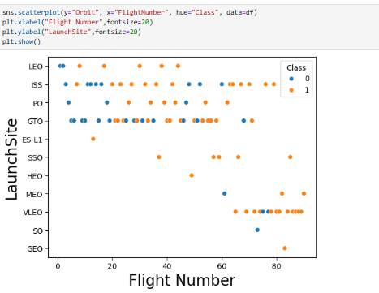
visualization results

Slide 14
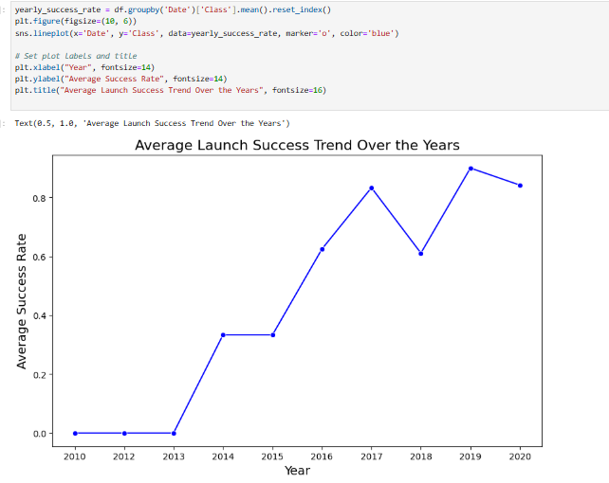
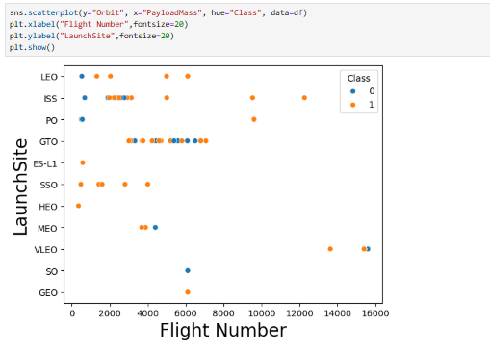
visualization results

Slide 15
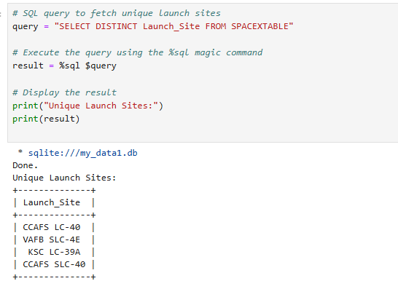
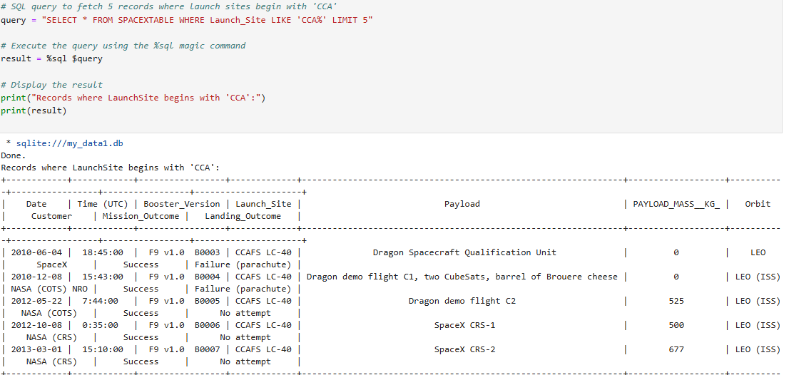
SQL results

Slide 16
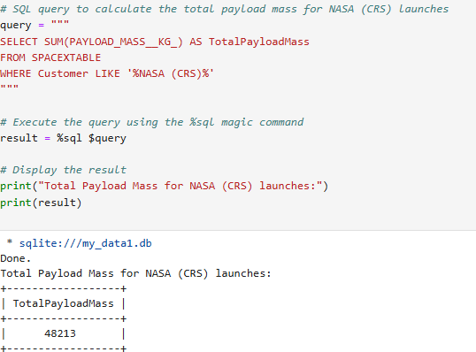
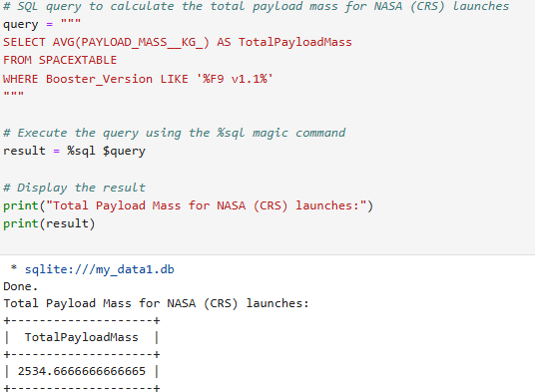
SQL results

Slide 17
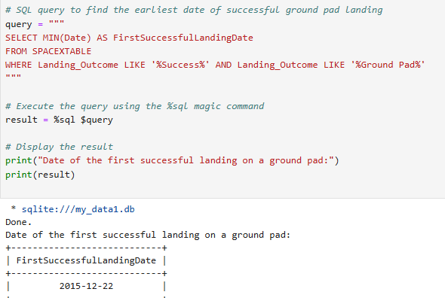
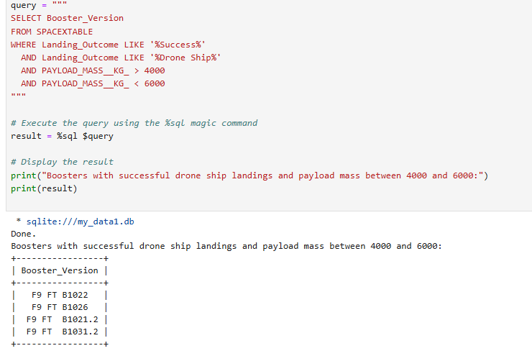
SQL results

Slide 18
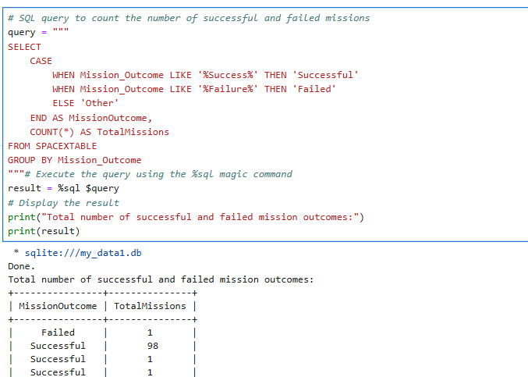
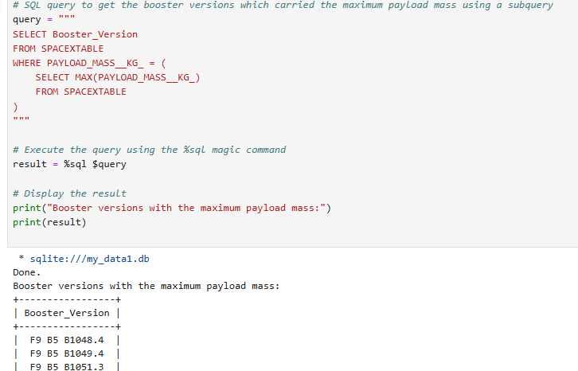
SQL results

Slide 19
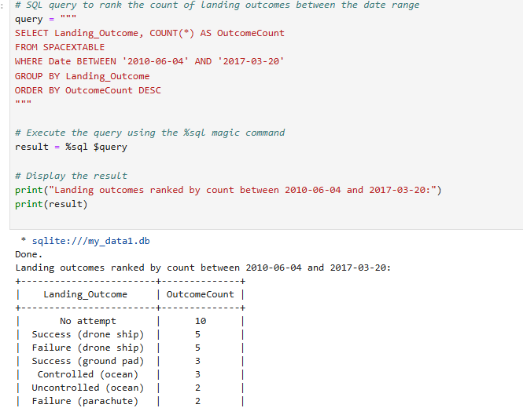
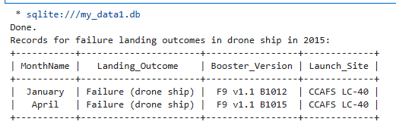
SQL results

Slide 20
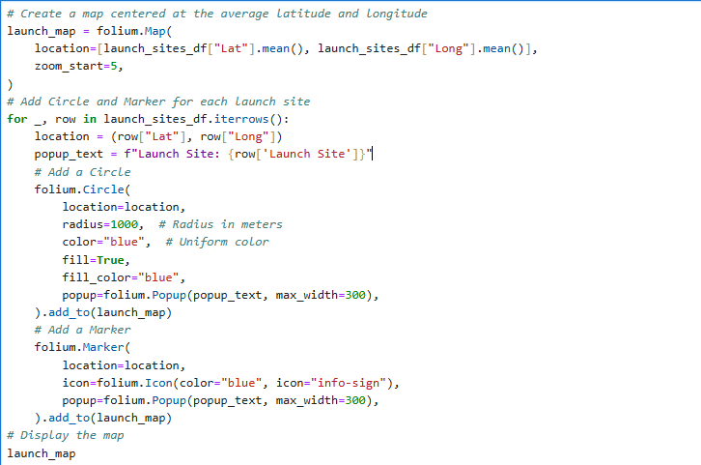
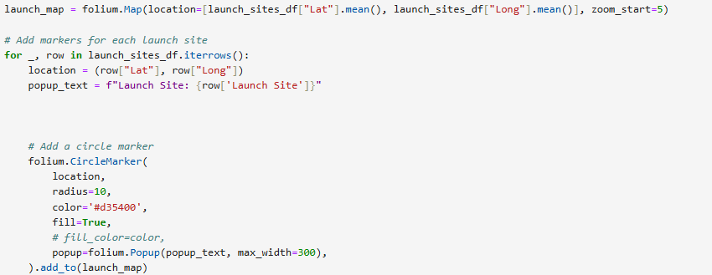
Folium results

Slide 21
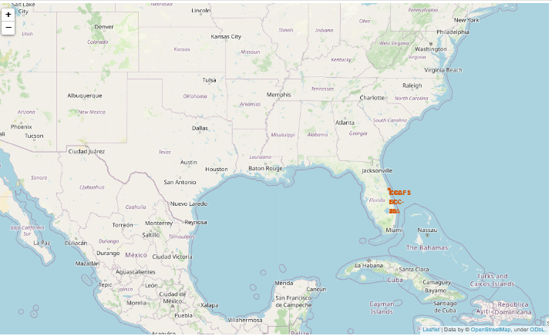
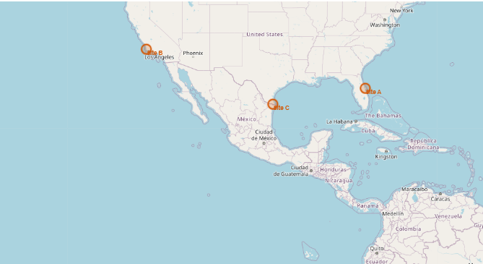
Folium results

Slide 22
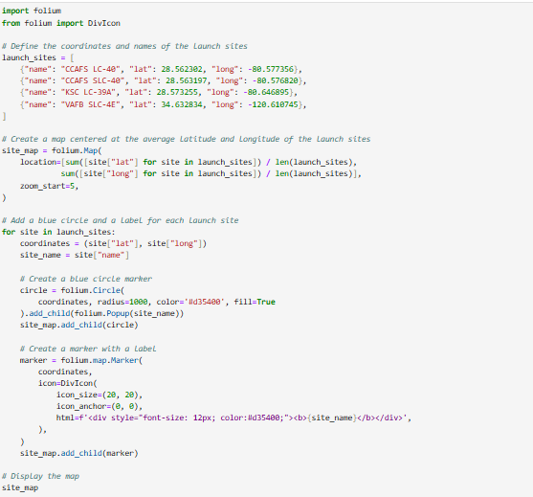
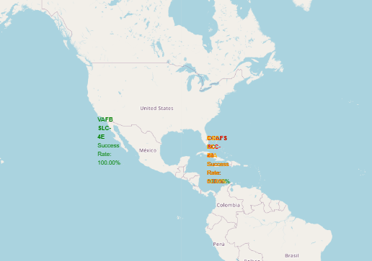
Folium results

Slide 23
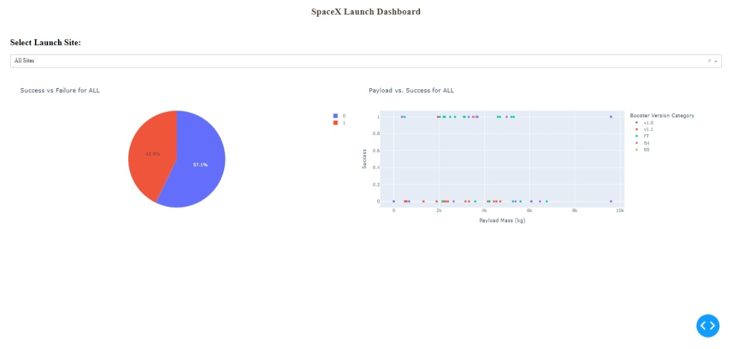
Dash dashboard results

Slide 24
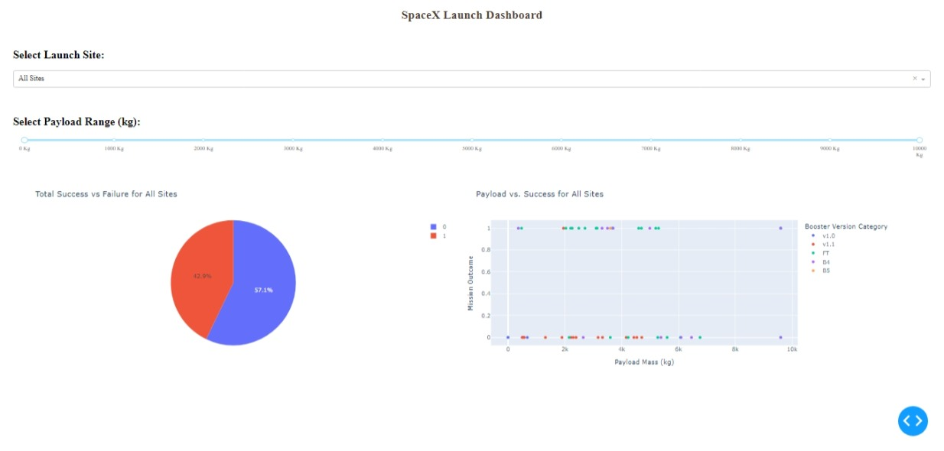
Dash dashboard results

Slide 25
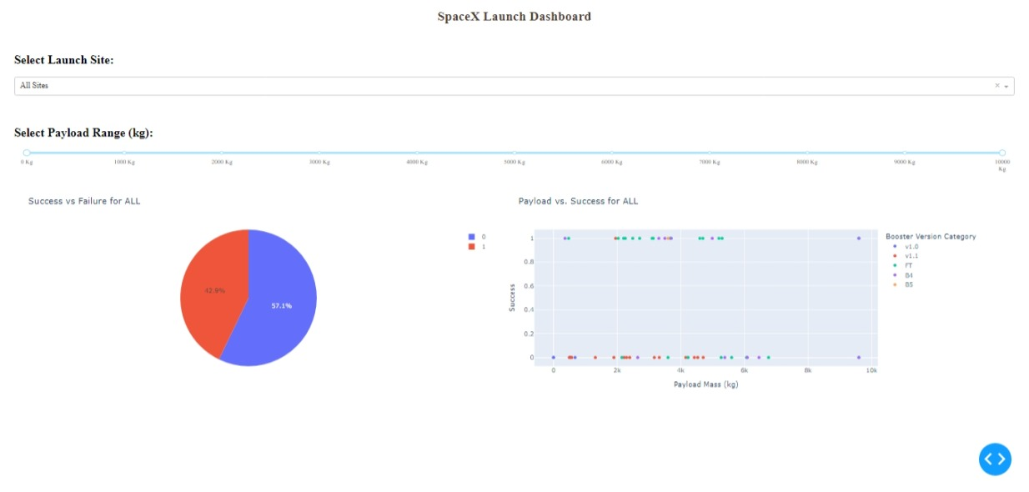
Dash dashboard results

Slide 26
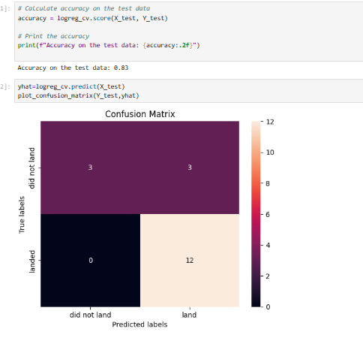
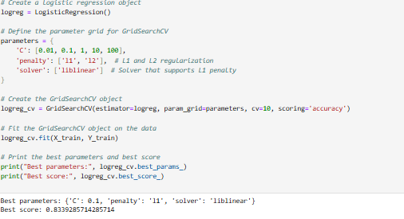
predictive analysis

Slide 27
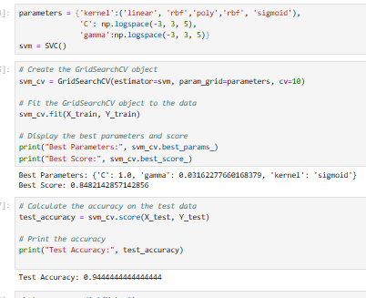
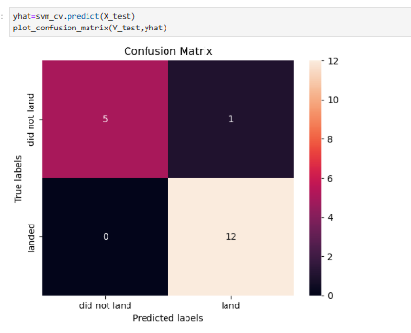
predictive analysis

Slide 28
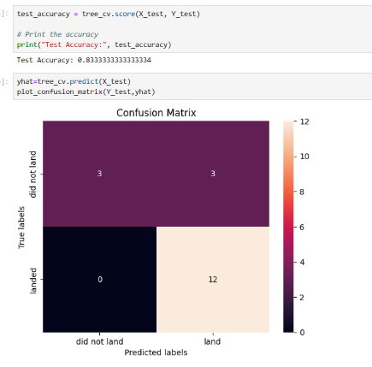
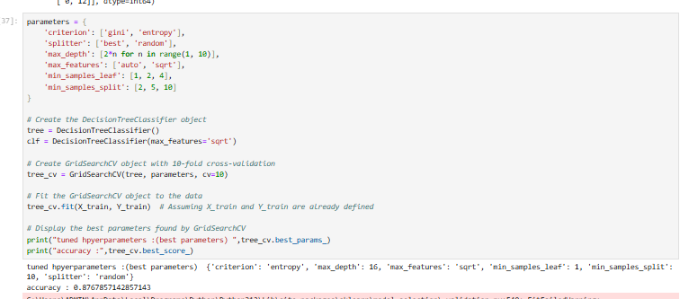
predictive analysis

Slide 29
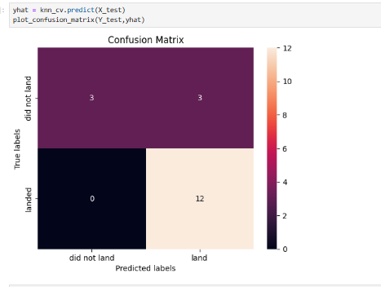
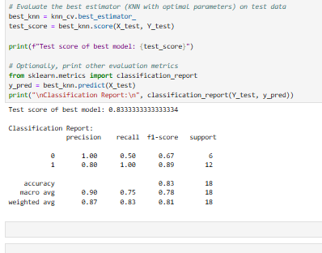
predictive analysis

Slide 30
Conclusion
The analysis conducted in this project provides valuable insights into SpaceX's operations and highlights key factors influencing successful launches. By exploring historical launch data, we identified the critical role of launch site selection, payload characteristics, and weather conditions in achieving mission success. The findings revealed patterns and trends that can guide decision-making, ultimately contributing to higher efficiency and reliability in SpaceX's operations.
The predictive models developed during the analysis offer a robust framework for anticipating launch outcomes. These models can help SpaceX proactively allocate resources, optimize scheduling, and mitigate risks associated with launch failures. By leveraging machine learning techniques, SpaceX can also forecast mission success probabilities, identify cost-saving opportunities, and enhance overall operational performance.
Overall, this project demonstrates the transformative potential of data-driven strategies for advancing SpaceX’s operational excellence and solidifying its leadership in the aerospace industry.

